Slide 1
Trees

Slide 2
What is a Tree ADT?
Inserting in a linked list is fast but searching is slow
Searching in a array arranged for binary chopping is fast but inserting is slow
Can we combine these ideas so as to get the advantages of both? The answer is to use a tree
Consider binary chopping on the following array:
  Arthur, Brian, Charles, Dennis, Edward, Fred, James, Jean, Joyce, Kay, Peter, Richard, Steve, Xenia, Yvonne.
The way in which comparisons are made can be illustrated as follows

Slide 3
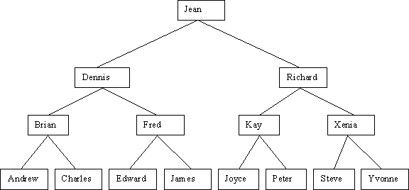

Slide 4
Properties of Trees
The boxes on the tree are called nodes
The nodes immediately below (to the left and right of) a given node are called its children
The node immediately above a given node is called its parent
The (unique) node without a parent is called the root
A node with no children is called a leaf
Two children of the same parent are said to be siblings
A node can be an ancestor (e.g. grandparent) or a descendant (e.g. great-grandchild)

Slide 5
Binary Search Trees
The tree we have drawn is a binary search tree
  binary because no node has more than two children
  search because the nodes are ordered for convenience in searching
Notice that a node and its descendants themselves constitute a binary search tree, a sub-tree of the original tree
A binary tree is either empty or it consists of a node called the root together with two binary trees called the left sub-tree and the right sub-tree of the root

Slide 6
Binary Search Tree definition
A binary search tree is a binary tree that is either empty or one in which each node contains a key that satisfies the following conditions:
  All keys (if any) in the left sub-tree of the root precede the key in the root
  The key in the root precedes all keys (if any) in its right sub-tree
  The left and right sub-trees of the root are again binary search trees

Slide 7
Implementing a Binary Search Tree
The nodes may be represented by a class:
public class TreeNode
{
private Comparable data;
private TreeNode left;
private TreeNode right;
...
}
• There can be various constructors

Slide 8
The Tree itself
public class BinarySearchTree
{
private TreeNode root;
// No need for a constructor
…
}
root
root
data
left
right

Slide 9
Some Tree methods
To start with, consider methods:
  insert
  remove
  isEmpty
public void insert (Comparable element)
public boolean remove (Comparable element)
(returns true if the element is found and removed, otherwise false)
public boolean isEmpty ( )
{
return root == null;
}

Slide 10
Inserting an element
If the tree is empty, we simply do:
root = new TreeNode (element, null, null);
16
Less than or equal to 16,
insert here
Greater than 16,
insert here
The rest of
the tree

Slide 11
Inserting an element (contd)
We use a pointer to our current position in the tree (called a cursor)
Start with the cursor at the root of the tree
If the new element is less than or equal to the data at the cursor:
  if the left child at the cursor is null, create a new node for the element pointed to by the cursor’s left link
  otherwise, move the cursor left and repeat
Otherwise, do as above but using the right child

Slide 12
Removing an element from a Tree
For this operation, we need a cursor (as before) and also another pointer which we will call parentOfCursor
Start by setting the cursor to the root of the tree, and parentOfCursor to null
Move the cursor down the tree until we find the element to be removed, or until the cursor falls off the bottom (meaning that the element was not in the tree)
As we are about to move the cursor down, set parentOfCursor = cursor
There are now four possibilities

Slide 13
Removing an element (contd.)
1 The cursor is null, meaning that the element was not in the tree, so return false
2 The element to be removed is a leaf node (no children); this case is easy, the node can simply be removed by setting the appropriate pointer from the parent node to null — removing the root node is a special case
3 The element to be removed has only one child; again easy; make the parent of the node to be deleted into the parent of the non-empty child (by setting the appropriate child of parentOfCursor to the appropriate child of cursor) — again, removing the root node is a special case

Slide 14
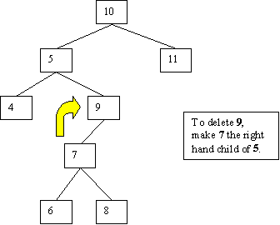

Slide 15
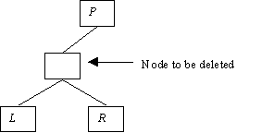
Removing an element (contd.)
4 Both left and right children of the node to be deleted are non-empty – harder: call the right hand child of the node to be deleted R, its left hand child L and its parent P

Slide 16
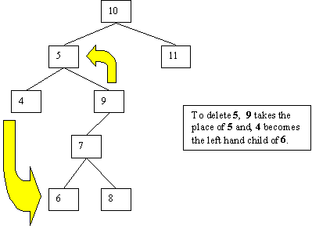
Make R the child of P replacing the node to be deleted and make L the leftmost descendant of R

Slide 17
Tree Traversal
Suppose we want to visit every node of a tree
There are several ways to do this
For a search tree, the obvious way is to visit the nodes in order, so this is called in-order traversal
public void inOrder (TreeNode cursor)
{
if (cursor == null)
return;
inOrder(cursor.getLeft( ));
System.out.println(cursor.getData( ));
inOrder(cursor.getRight( ));
}
An overloaded method to
start displaying at the root:
public void inOrder ( )
{
inOrder(root);
}

Slide 18
Tree Traversal (contd.)
Other traversal orders are pre-order and post-order:
public void preOrder (TreeNode cursor)
{
if (cursor == null) return;
System.out.println(cursor.getData( ));
preOrder (cursor.getLeft( ));
preOrder (cursor.getRight( ));
}
public void postOrder(TreeNode cursor)
{
if (cursor == null) return;
postOrder (cursor.getLeft( ));
postOrder (cursor.getRight( ));
System.out.println(cursor.getData( ));
}
Can also have overloaded methods
like the one on the previous slide

Slide 19
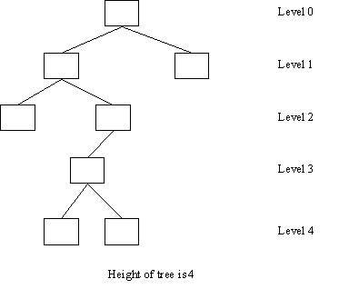
Analysis
We need some terminology:
  the level of a node is the number of branches traversed in reaching it from the root; the root has level 0
  the height of a tree is the maximum level number that occurs

Slide 20
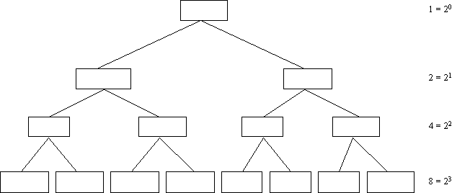
Analysis (contd.)
A complete binary tree of height h has 1 + 2 + 4 + … + 2 ^{h} = 2^{h+1} –1 nodes

Slide 21
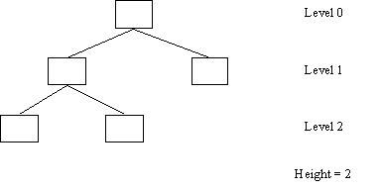
Balanced Trees
A binary tree is balanced if there is no binary tree of lesser height that can have the same number of nodes
For example, the maximum number of nodes in a tree of height 1 is 3, so this tree is balanced:

Slide 22
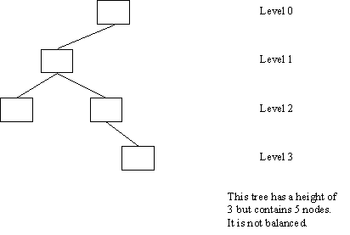
Balanced Trees (contd.)
Balanced trees give the best search/insert times for a given number of nodes

Slide 23
Balanced Trees (contd.)
Since the number of nodes in a complete binary tree of height h is 2^{h+1} – 1, a binary tree of n elements is balanced if:
2^{h} – 1 < n ≤ 2^{h+1} – 1
So, finding an element, inserting, and removing in a balanced tree containing n elements are O(log n) operations
Unfortunately, binary search trees can become unbalanced and, in the worst case, these operations then become O(n)
There are algorithms for balancing binary search trees — they tend not to be very useful because we usually need to keep the tree balanced when we do insertions and deletions, rather than balance it once and for all

Slide 24
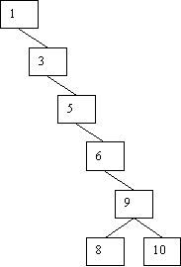
An unbalanced tree

